Slide 1

DF
LECTURE
Live Response
Diploma in CSF/IT
Year 2/3 (2022/23), Semester 4/6
Digital Forensics
9
Notes:
Left-hand Bar – Replace FSP by your module code and X by the lecture number.
Replace Lecture Title
Replace < Module Name >
Replace Year and Semester if necessary

Slide 2
Objectives
At the end of this, you will get to know more about:
Variations of live response
Order of volatility
Collecting volatile and nonvolatile data
Windows Registry

Slide 3
Live Response
Live data are volatile data residing in RAM, registries, caches or in transit.
It is collected in nearly every incident response investigation.
Main purpose is to preserve volatile evidence that will further the investigation.
Live data collection (or live response) can be risky (system may crash or evidence may be destroyed) so it is important to minimize changes to system during collection process.

Slide 4
Live Response – cont.
A live response is conducted when a computer system is still powered on and running. This means that the information contained in these areas must be collected without impacting the data on the compromised device. There are three variations of live response:
Initial live response This involves obtaining only the volatile data from a target or victim system. An initial live response is usually performed when you have decided to conduct a forensic duplication of the media.

Slide 5
Live Response – cont.
In-depth response This goes beyond obtaining merely the volatile data. Nonvolatile information such as log files are collected to help understand the nature of the incident.
Full live response This is a full investigation on a live system. All data for the investigation is collected from the live system, usually in lieu of performing a forensic duplication.

Slide 6
Live Response – cont.
Live response is frequently performed during intrusion detection.
Factors to consider when deciding if a live response is appropriate for a given situation:
Is the live data contains information critical to the investigation that is not present elsewhere?
Can the live response be run in an ideal manner, minimizing changes to the target system?
Is the number of affected system large, making it infeasible to perform forensic imaging?
Will the forensic duplication take excessive amount of time?

Slide 7
What to collect?
In most cases, information from 2 categories are collected:
Data that describes current state of system. E.g. network connections and running processes
Information that is less volatile and provides a snapshot of important information that can answer questions about what happened in the past. E.g. file listing, system logs, or other OS or application specific data

Slide 8
Live System Duplication
A live system duplication is defined as the creation of an image in a system that is actively running.
This situation is not preferred, but is sometimes the only option. Example:
The system may be an extremely business-critical system that cannot be taken down except during very short maintenance windows.
Encrypted drives that would not be accessible after system was shut down.
Performing live image will make minor modifications to the system.

Slide 9
Live System Duplication – cont.
Be sure to document
what you did,
what tool you used,
the procedure you followed,
what services may be running, and
the exact dates and times.
You may need these information in case you are challenged by someone that you modified the system.

Slide 10
Order of Volatility
The order of collection should proceed with the most volatile to least volatile. Order of volatility for a typical system:
Register and cache
Memory and process table
Temporary file system (for Unix-like system)
Disk or other storage media
Physical configuration and network topology
Archival media

Slide 11
Collecting Volatile Data
List of the steps to use for volatile data collection:
Record the system time and date.
List current and recent connections.
Determine open ports.
List applications associated with open ports.
Determine who is logged in to the system
List all running processes.
Record modification, creation, and access times of all files.
(We’ll perform these steps in Practical 9)

Slide 12
Collecting Nonvolatile Data
If forensic duplication is difficult or impossible, some nonvolatile data maybe obtained while machine is running, e.g.:
File system data and time stamp
Auditing policy
System event logs (we’d covered this in Lecture 3)
User accounts
Suspicious files
Registry data

Slide 13
File System Date and Time Stamp
A command called find can be found in the UnxUtils package.
http://sourceforge.net/projects/unxutils/
This command prints, one line for each file, any of the file’s attributes desired.
With the following command, we can print the file permissions, last access date and time, modification date and time, created date and time, user ownership, group ownership, file size, and the full path of every file on the C: drive:
Find c:\ -printf “%m;%Ax;%AT;%Tx;%TT;%Cx;%CT;%U;%G;%s;%p\n”

Slide 14
Auditing Policy
Without proper auditing, there will not be security related logs.
Before audit records are logged, an auditing policy must be established. The policy defines the types of events that will be audited.
Administrators should be selective in determining the objects to audit. Auditing creates system overhead, therefore auditing too many objects will cause the security log to become large and difficult to manage.

Slide 15
Auditing Policy – cont.
To minimize the risk of several specific security threats, the administrator can take various auditing steps.
The following table provides an example of various events that could be audited, as well as the specific security threat that the audit event monitors.
Audit Event | Potential Threat
Failure audit for logon/logoff | Random password hack
Success audit for logon/logoff | Stolen password break-in

Slide 16
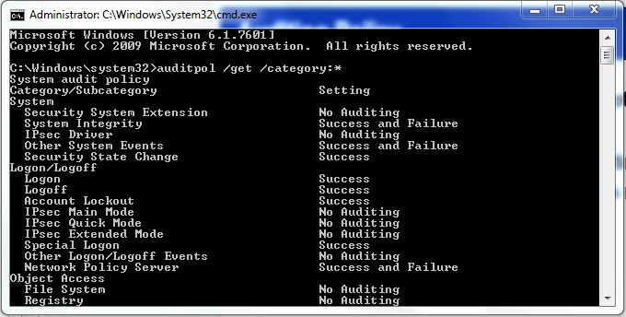
Auditing Policy – cont.
The command to determine the auditing policy is auditpol, distributed with Microsoft’s resources kit. (run cmd with Administrator right)

Slide 17
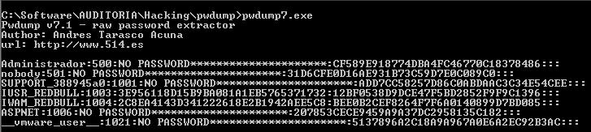
User Accounts
The easiest type of backdoor for an intruder to use is one that will blend into the normal traffic patterns for the victim machine.
Therefore, it would make sense for the attacker to create a new user so that he could log into the same services that valid users utilized.
It is simple to dump the user accounts using pwdump utility.

Slide 18
Suspicious Files
If we are not acquiring a forensic duplication, we could transfer any suspicious files using netcat.
The syntax for the command to run on the forensic workstation is:
nc -v -l -p 2222 > filename
(Netcat options: -v for verbose, -l for listening, -p for port)
Type the following command on victim’s computer to transfer the file named filename to forensic workstation:
type filename | nc forensic_workstation_ip_address 2222
(type command displays file content)

Slide 19

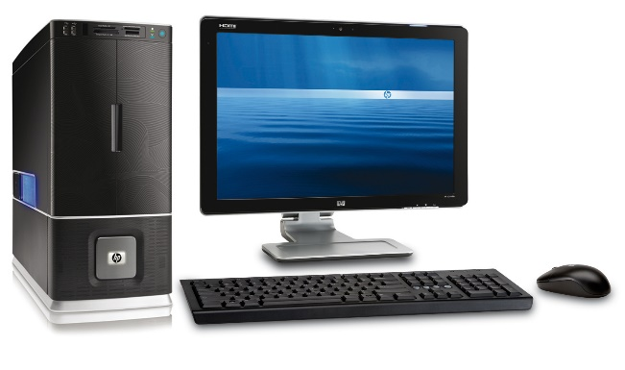
Suspicious Files – cont.
type abc.docx | nc 10.0.1.1 2222
nc -v -l -p 2222 > abc.docx
Victim’s Computer
Forensic Workstation
IP address: 10.0.1.1

Slide 20
The Windows Registry
The registry serves as the primary database of configuration data for the Windows OS and applications that run on it.
It is organized into a number of system and user-specific “hives”.
A hive is typically stored in a single file on disk.
These hive files are not human readable, but can be parsed using variety of tools.

Slide 21
The Windows Registry – cont.
Registry
Hives
SECURITY
SYSTEM
SOFTWARE
DEFAULT
SAM
NTUSER.DAT
USRCLASS.DAT

Slide 22
The Windows Registry – cont.
Windows maintains five main registry hives in the path %SYSTEMROOT%\system32\config:
SYSTEM,
SECURITY,
SOFTWARE,
SAM, and
DEFAULT.
These are the actual hive file names, they do not have an extension.

Slide 23
User-Specific Registry Hives
User-specific registry hives are stored within each user’s respective profile directory.
Two user hives, NTUSER.DAT and USRCLASS.DAT are stored in different locations, depending on the versions of Windows.
Windows XP and Server 2003
\Documents and Settings\<user>\NTUSER.DAT
\Documents and Settings\<user>\Local Settings\Application Data \Microsoft\Windows\USRCLASS.DAT
Windows Vista, 7, and Server 2008
\Users\<user>\NTUSER.DAT
\Users\<user>\AppData\Local\Microsoft\Windows\USRCLASS.DAT

Slide 24
User-Specific Registry Hives – cont.
Windows only maintains profile data for users who have interactively logged on to a system.
Interactive logon is a logon process whereby the user gains access to the network by entering a username and password in response to a dialog box on the local console. This is in contrast to a remote logon, which occurs when a user who is already logged on locally tries to make a network connection to a remote computer—for example, using the net use command at the command prompt.
If a user has only established a network logon, the system will not contain a profile directory or registry hive for that specific account.
This means that the absence of user profile directory does not indicate that user has never authenticated to the system.

Slide 25
Registry Structure
Information within the registry is stored in a tree structure that can be broken down into three key components: keys, values, and data.
If compared to a file system, consider a key analogous to a directory path, a value to a file name, and data to the file content.

Slide 26
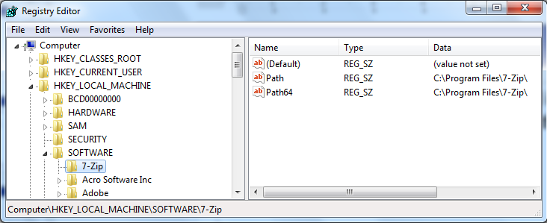
Registry Structure – cont.
The figure shown below is an example of a registry’s key, value, and data in Windows registry editor (regedit.exe).
As shown, HKEY_LOCAL_MACHINE\SOFTWARE\7-Zip is the key, Path or Path64 is the value and C:\Program Files\7-zip\ is the data.
Key
Value
Data

Slide 27
Registry Hives and Mapping
As mentioned, the registry is maintained across multiple “hive files”, including both user-specific and system-wide hives.
A running instance of Windows maps the contents of these hives into a tree structure that begins with a set of “root keys”.
The root registry keys are as follows:
HKEY_LOCAL_MACHINE (aka HKLM)
HKEY_USERS (aka HKU)
HKEY_CURRENT_USER (aka HKCU)
HKEY_CURRENT_CONFIG (aka HKCC)
HKEY_CLASSES_ROOT

Slide 28
Registry Hives and Mapping – cont.
The various hive files are represented within the root keys as follows:
HKEY_LOCAL_MACHINE (aka HKLM)
HKLM\Software, HKLM\Security, HKLM\System, and HKLM\SAM subkeys contain the contents of the SOFTWARE, SECURITY, SYSTEM, and SAM hives respectively.

Slide 29
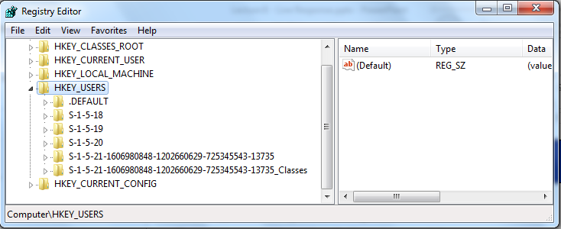
Registry Hives and Mapping – cont.
HKEY_USERS (aka HKU)
HKU contains the following subkeys:
HKU\.DEFAULT maps to the DEFAULT hive
HKU\{SID} exists for each user security identifier (SID) on the system. The subkeys for each SID maps to the corresponding user’s NTUSER.DAT hive file.
HKU\{SID}_Classes exists for each user SID on the system. The subkey for each SID maps to the corresponding user’s USRCLASS.DAT hive file.

Slide 30
Registry Hives and Mapping – cont.
HKEY_CURRENT_USER (aka HKCU)
HKCU is simply a symbolic link to HKU\{SID} for the user currently logged in to the console.
HKEY_CURRENT_CONFIG (aka HKCC)
HKCC maps HKLM\SYSTEM\CurrentControlSet\Hardware Profiles\XXXX, where XXXX is a 4-digit number representing the active profile.
HKEY_CLASSES_ROOT
HKEY_CLASSES_ROOT is presented as a merged set of subkeys from HKLM\Software\Classes and HKCU\Software\Classes.

Slide 31
Registry Hives and Mapping – cont.
Note that the virtual key paths such as HKEY_CURRENT_CONFIG or HKEY_CURRENT_USER, or even some subkeys such as HKLM\SYSTEM\CurrentControlSet are only exists on a live system.
(we shall explore more on Windows Registry in Tutorial 9)

Slide 32
Summary
Live response involves collecting volatile and non-volatile data.
The sequence of data collection depend on the order of volatility.
Windows Registry contains all of the configuration setting of specific users, groups, hardware, software, and networks, and it is viewed as a gold mine of forensic evidences which could be used in courts.

Slide 33
Reference Book
Jason T. Luttgens, Matthew Pepe, Kevin Mandia, Incident Response & Computer Forensics (3rd Edition), McGraw-Hill Education

